Slide 1
Vocabulary 14

Slide 2
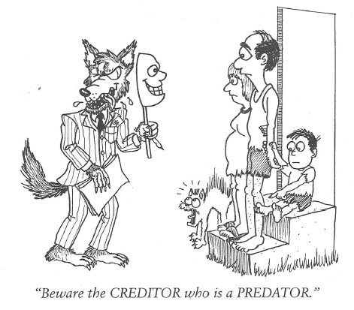
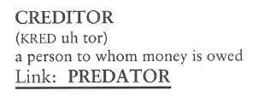
Creditor (N)
The entire banking industry is based on performing as a CREDITOR for depositors, then turning around and becoming CREDITORS for borrowers.

Slide 3
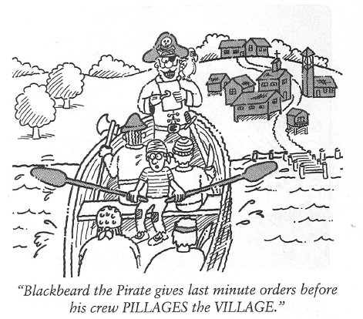
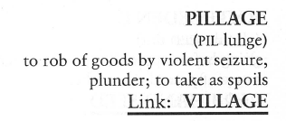
Pillage (V, N)
After the kids and their school friends PILLAGED the refrigerator, there was nothing left but a little catsup and mustard.

Slide 4
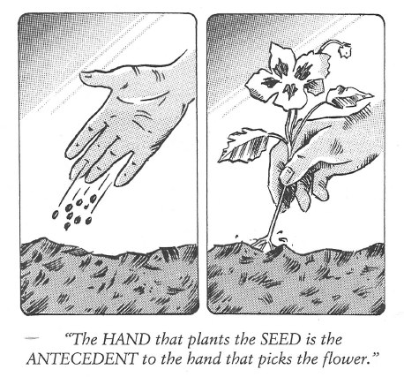
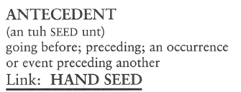
Antecedent (N, adj)
The atomic bomb was the ANTECEDENT to the hydrogen bomb.

Slide 5
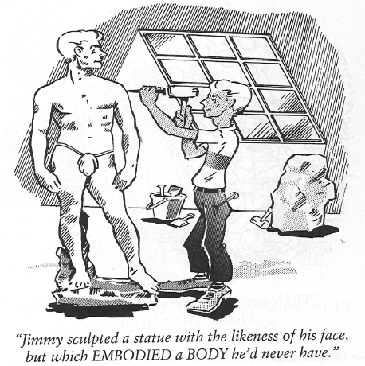
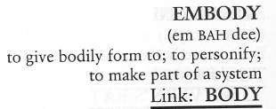
Embody (V)
The EMBODIMENT of basic Christian virtues is to be found in the Boy Scouts’ oath every Scout must take to become a member.

Slide 6
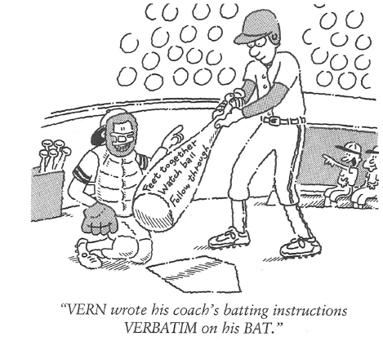
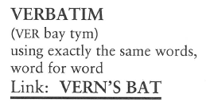
Verbatim (Adj, Adv)
The witness told the judge he couldn’t recite what the accused had said VERBATIM, but the essence of what he said was the accused thought the coach was “on the take.”

Slide 7
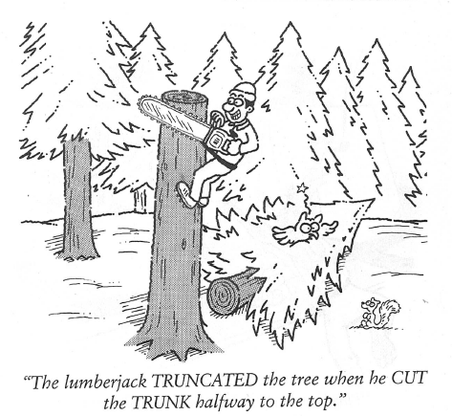
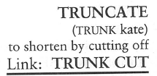
Truncate (V, Adj)
Observing his listeners were falling asleep, the president TRUNCATED his speech so everyone could go home.

Slide 8
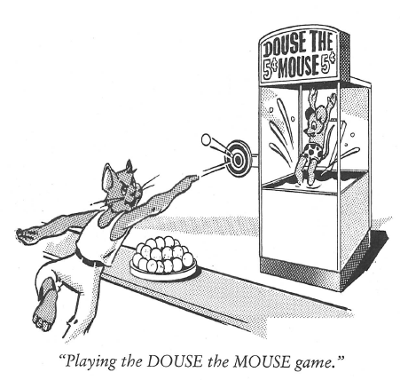
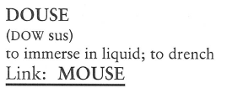
Douse (V)
I quickly DOUSED the rumor I was leaving the company and going to work for one of our competitors by going directly to the president and telling him there was absolutely no truth to it.

Slide 9
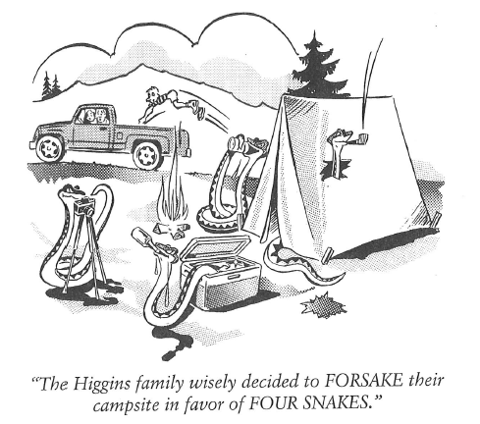
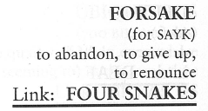
Forsake (V)
All the general’s troops had FORSAKEN him, leaving him no choice but to follow them and return to safe ground.

Slide 10
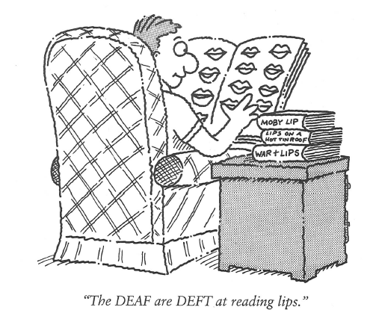
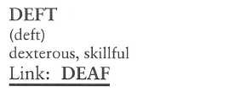
Deft (Adj)
The magician was so DEFT with a pack of cards he could deal off the bottom with everyone watching, and no one was the wiser.

Slide 11
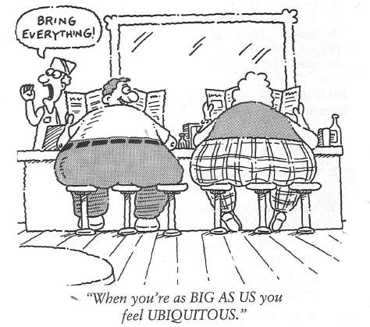
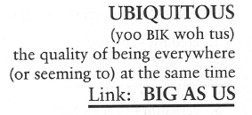
Ubiquitous (Adj)
Computers were once rare, but today they are more UBIQUITOUS than typewriters.

