Slide 1
Vocabulary 18

Slide 2
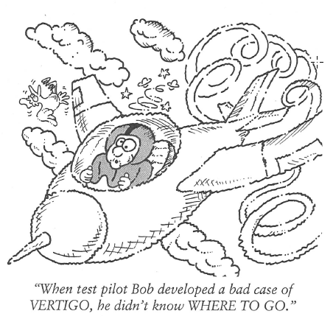
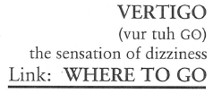
Vertigo (N)
Charles was acrophobic and even suffered from VERTIGO while standing on a stool, replacing the light bulbs in the kitchen.

Slide 3
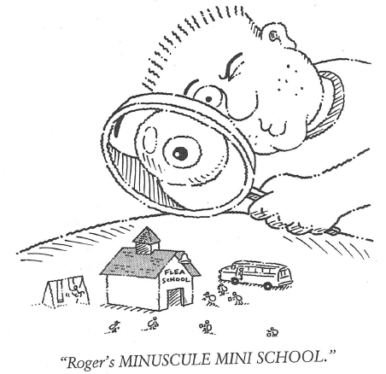
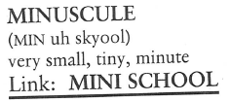
Miniscule (N, Adj)
From the top of the Empire State Building everything below looks MINISCULE—about the same size as an ant.

Slide 4
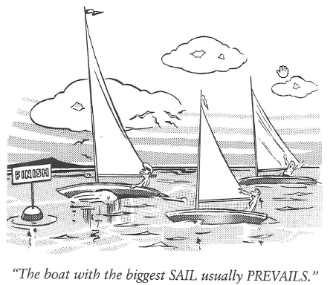
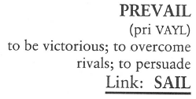
Prevail (V)
(PREVAILING means predominant.) The PREVAILING winds were out of the northwest most of the summer months.

Slide 5
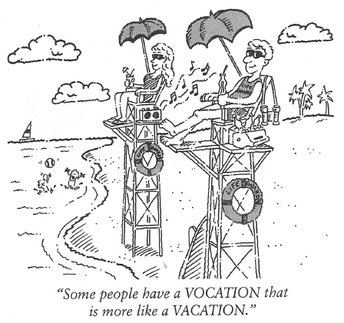
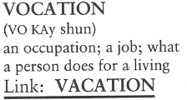
Vocation (N)
(A VOCATION is a person’s job, while an AVOCATION is a person’s hobby.) Christopher’s VOCATION is banking, but his AVOCATION is growing miniature orchids on the weekends.

Slide 6
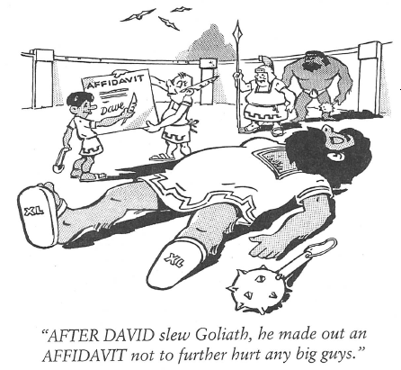
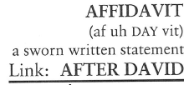
Affidavit (N)
Roseanne had an AFFIDAVIT from her neighbor giving her permission to cut down the tree on their mutual property line.

Slide 7
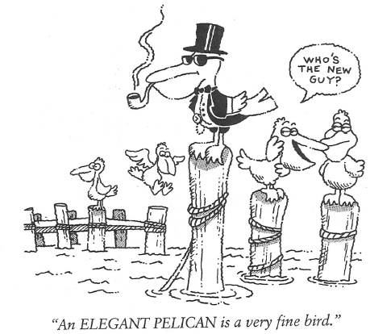
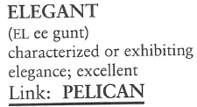
Elegant (Adj)
The presidential ball was an ELEGANT affair. Nobody but the Turkistan ambassador ate with their hands.

Slide 8
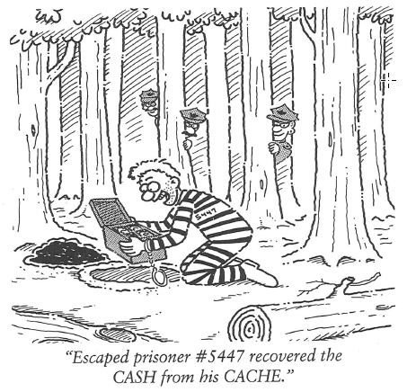
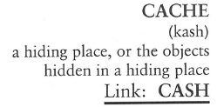
Cache (N, V)
When Sam worked for the C.I.A, he directed a movie on CACHING—how to hide booty where it would not be discovered and would remain hidden until an agent was ready to recover the contents.

Slide 9
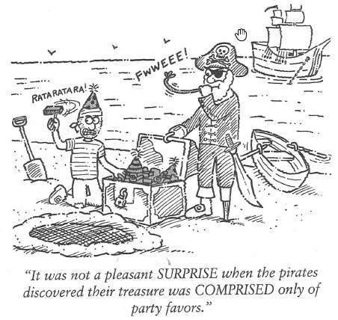
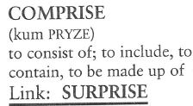
Comprise (V)
If we had one more kitten in the house, the litter would COMPRISE thirteen.

Slide 10
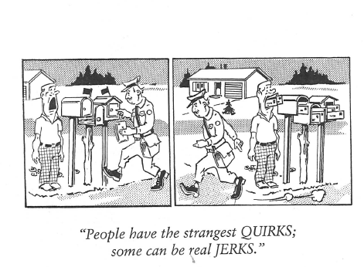
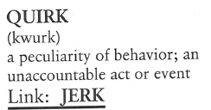
Quirk (N, V)
Have you ever noticed Brad has the strangest QUIRK? Every time someone mentions the word “work,” his leg jerks.

Slide 11
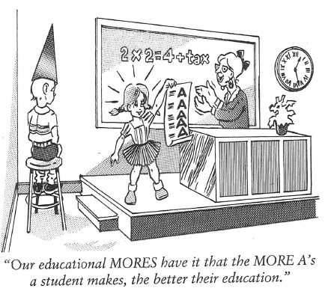
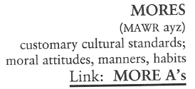
Mores (N)
According to Chinese MORES, it is considered polite for dinner guests to belch at the table as a gesture of appreciation and enjoyment.

