Slide 1

Vocabulary 19

Slide 2
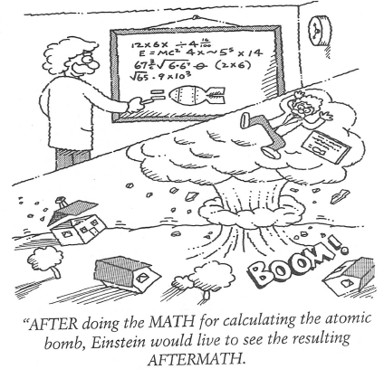
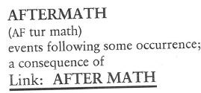
Aftermath (N)
The AFTERMATH of Christina skipping classes too often to practice ballet was flunking English 101.

Slide 3
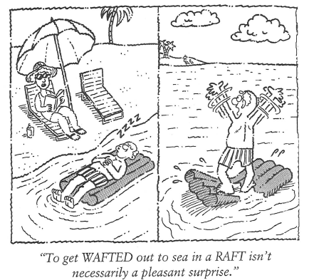
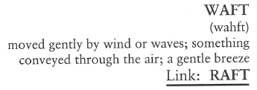
Waft (V, N)
The smell of cooked bacon WAFTING through the cabin let everyone know it was breakfast time.

Slide 4
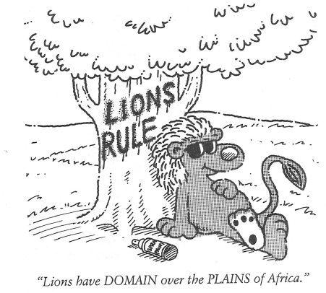
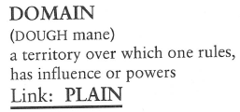
Domain (N)
The DOMAIN of the native Florida panther is in the Everglades and South Central Florida.

Slide 5
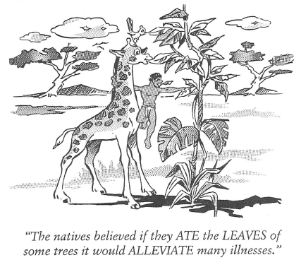
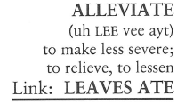
Alleviate (V)
When Peter arrived with sacks of ice for the BBQ, it ALLEVIATED the need to wait for the icemaker to produce more.

Slide 6
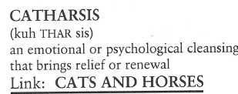
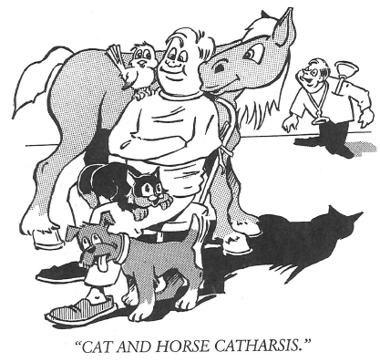
Catharsis (N)
After Jeremy returned to the French World War II battlefield, he had known fifty years before, he said he found the experience CATHARTIC.

Slide 7
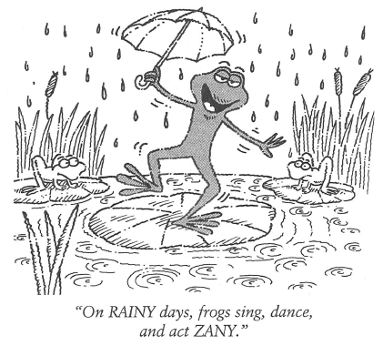
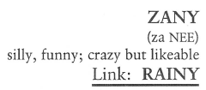
Zany (N, Adj)
The ZANIEST people I ever saw were an entire fraternity of guys trying to get into a telephone booth all at the same time.

Slide 8
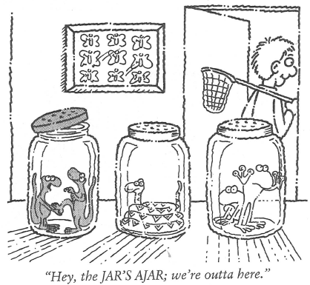

Ajar (Adj)
Even though Mr. Kramer had at first verbally rejected the offer to sell his hardware store, he left the offer AJAR by saying he would reconsider after the Christmas season.

Slide 9
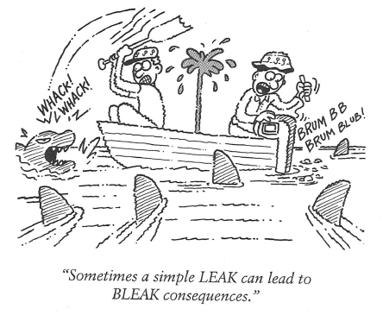
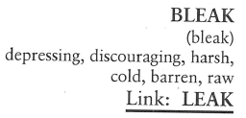
Bleak (Adj)
The vet said we should keep our hopes up, but the chance of our dog, Spot, surviving the car accident appeared BLEAK.

Slide 10
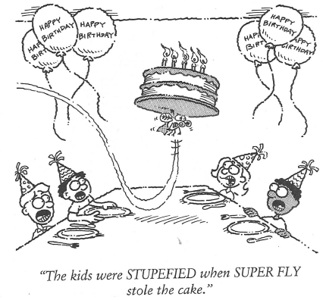
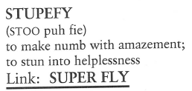
Stupefy (V)
The technician seemed STUPEFIED when he could not fix the computer.

Slide 11
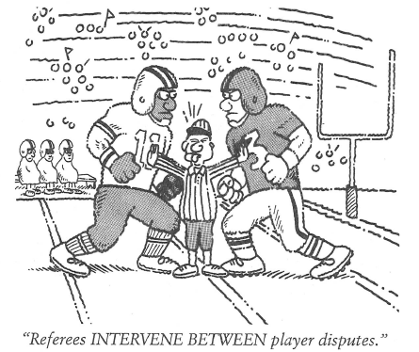
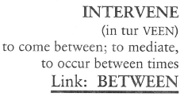
Intervene (V)
So much had happened to the family in the INTERVENING years since Brett had gone off to college. Brett felt nervous at the prospect of seeing his parents again now that they were no longer living together.

