Slide 1
Vocabulary
26

Slide 2
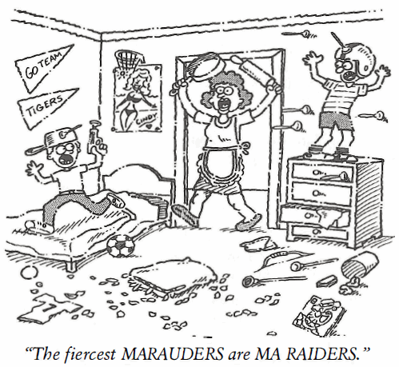
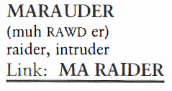
Marauder (N)
Among the legendary pirate MARAUDERS of the eighteenth century were Captain Kidd, Calico Jack Rackam, Charles Vane, Blackbeard, and Sir Henry Morgan.

Slide 3
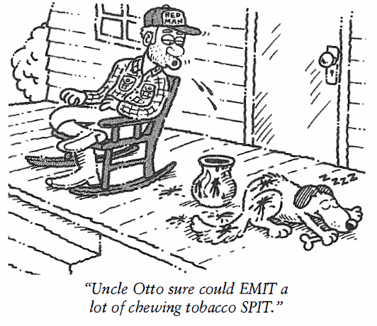
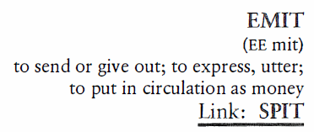
Emit (V)
David told the mechanic that the car EMITTED a strange sound when he started the engine.

Slide 4
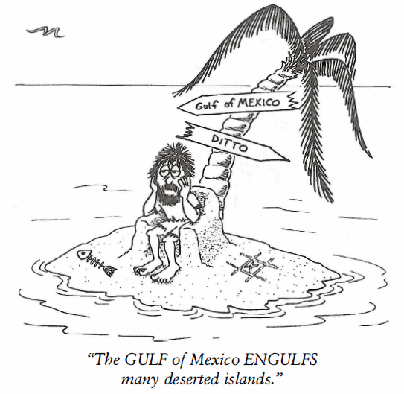
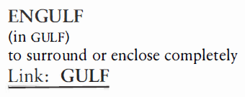
Engulf (V)
An ENGULFING movement by the Union troops cut off the Confederate retreat.

Slide 5
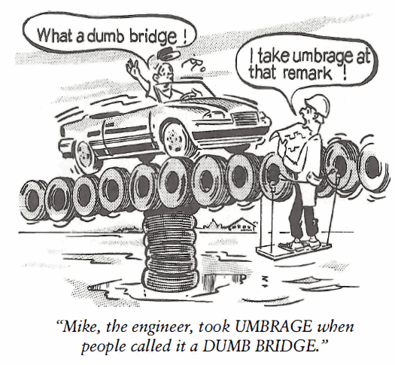
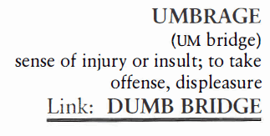
Umbrage (N)
"I take UMBRAGE at your remarks about my golf game," Theodore said jokingly to his regular golf partner. "I'm the only one you can beat."

Slide 6
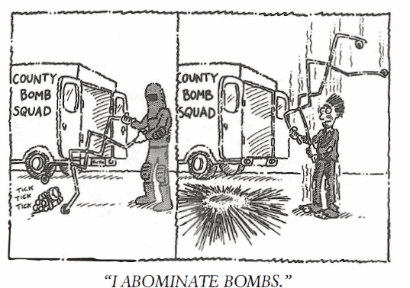
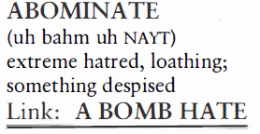
Abominate (V)
The movie was a real ABOMINATION of good taste, containing needless violence from the beginning to the end.

Slide 7
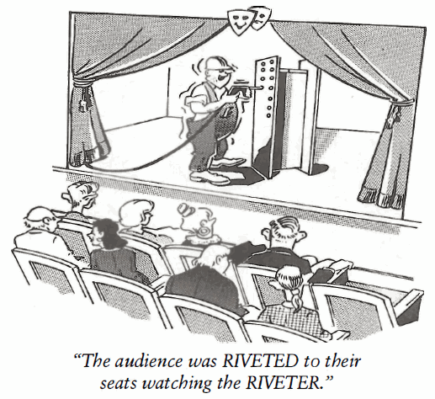
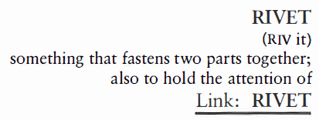
Rivet (N, V)
Most naval ships, army tanks, and fighter aircraft have metal plates for their outer bodies held together by RIVETS.

Slide 8
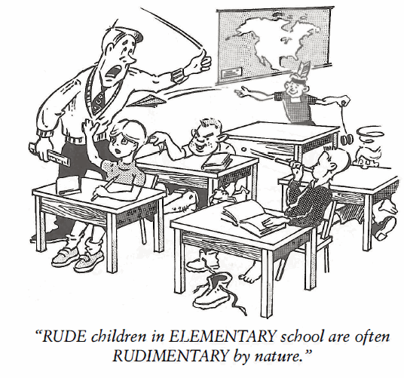
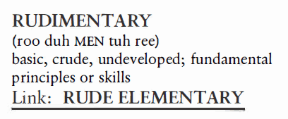
Rudimentary
(Adj)
"RUDIMENTARY, my dear Watson," Sherlock Holmes used to say to Dr. Watson when he had uncovered an important clue to a murder.

Slide 9
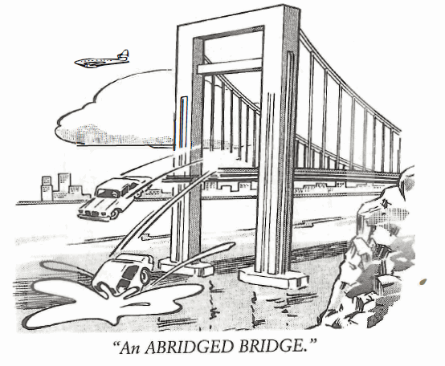
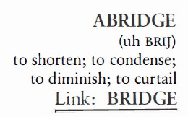
Abridge (V)
We saw an ABRIDGEMENT of the movie Gone with the Wind on TV last night; it only lasted two hours whereas the original lasts four hours.

Slide 10
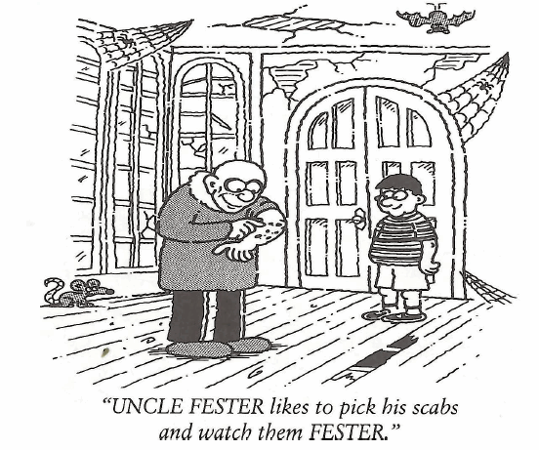
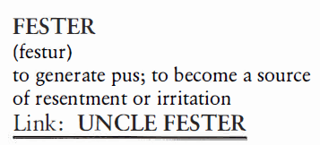
Fester (V)
Coach Jones’s resentments toward the complaining players on the team FESTERED until he finally told them to shut up or quit.

Slide 11
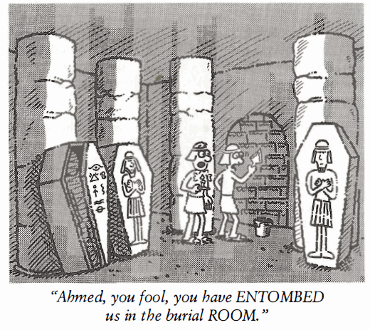
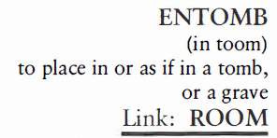
Entomb (V)
In the Pittsburgh coal mine disaster of 1938, thirty-six coal miners were ENTOMBED in a tunnel for thirteen days. Only fourteen survived.

