Slide 1
Office Politics: A Field Guide
Kelly P. Dwyer
July 9, 2007

Slide 2
The MBA

Slide 3
The Maverick

Slide 4
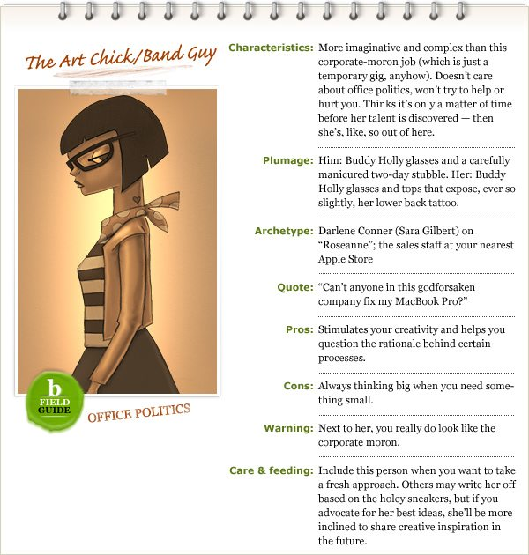
The Art Chick / Band Guy

Slide 5
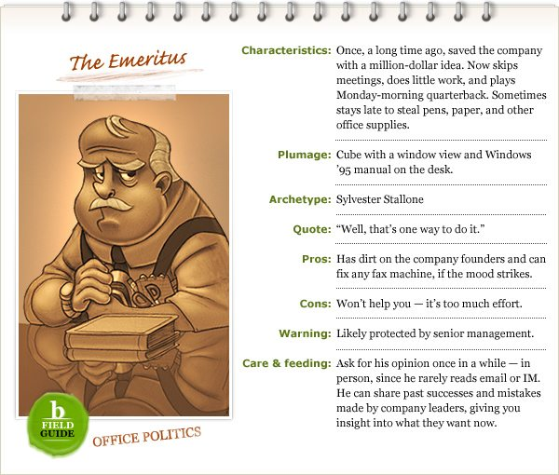
The Emeritus

Slide 6
The Sidekick

Slide 7
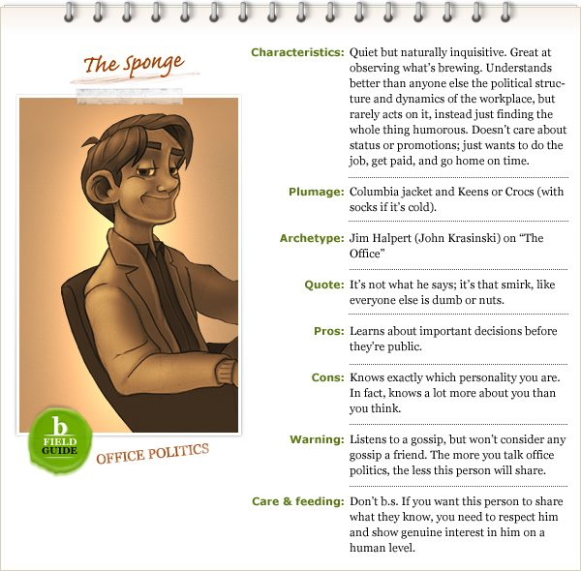
The Sponge

Slide 8
Den Mother / Cub Master

Slide 9
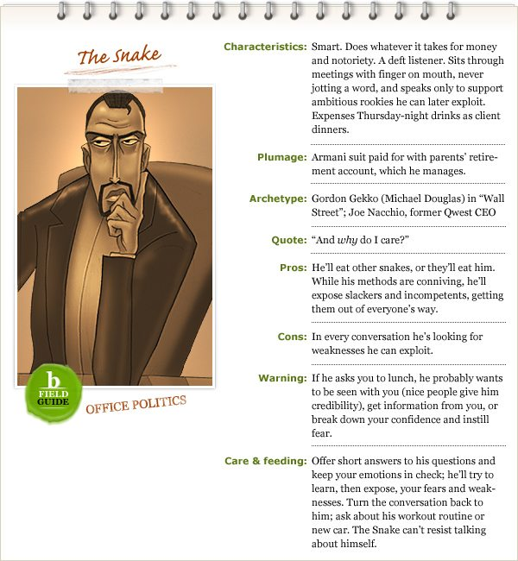
The Snake

Slide 10
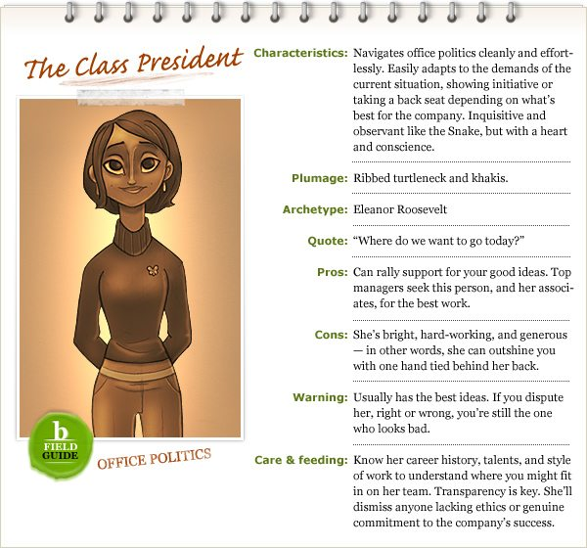
The Class President

Slide 11
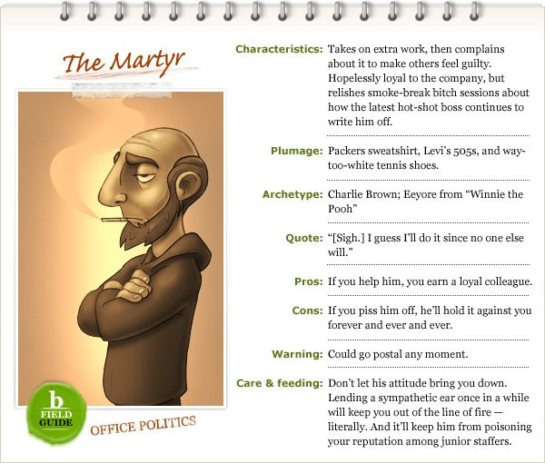
The Matyr

Slide 12
Resource
Dwyer, KP. (2007, July 9). Office politicos: a filed guide. Retrieved from http://www.bnet.com/article/office-politicos-a-field-guide/94033?tag=drawer;toc-drawer

