Slide 1
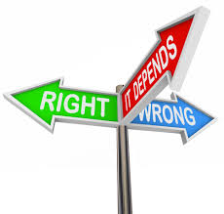
Did you bring your ethics today?

Slide 2
Code
Code refers to the expected conduct or the overall levels of acceptable behavior within a specified group. Basically, the rules that the group agrees to abide by. It is a way for businesses and non-profits alike to hold individuals accountable for personal actions. Both lawful and unlawful groups have a code to follow.

Slide 3
ethics
Ethics refers to the morality or integrity of an individual or group. Ethics are a system of ideas and beliefs about what is considered to be right and wrong. These “moral principles” often follow the outline of the “Golden Rule.”
Morality and integrity are internal concepts and what is considered to be moral and ethical to one individual, may not be moral and ethical to another. But “groups” of individuals tend to adopt a system or “code.”

Slide 4
What is a “code of ethics”?
So what then is a Code of Ethics and how does this relate to business?
A code of ethics related to business is a group of rules about what is considered to be right, wrong, and acceptable behavior within a “public” context. Specifically, these are rules about behavior, communication, dress, and overall expectations for employees that will allow people from various backgrounds and belief systems to work harmoniously together and be productive for the company.

Slide 5
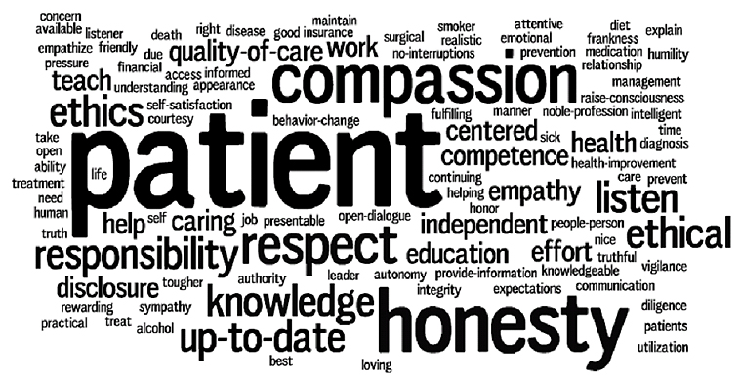
Professionalism
In recent years, businesses have replaced the term “ethics” and “integrity” with “professionalism.” The reality is they are the same.
  Honesty
  Blameless
  Courteous/Polite
  Maturity
  Responsible/Dependable
  Good Judgment
  Cleanly/Organized
  Optimistic/Enthusiastic
  Prompt

Slide 6
What is lost when things go wrong?
That said, can an individual, business, or corporation lose their integrity or “professionalism”? Or, is it just diminished, but not lost?
Think about companies and individuals that have been in current news stories after showing a lack of integrity or “professionalism.” Examples:
Toyota
GM
Penn State
Microsoft
Privacy and government
One World Trade Center-security breach

Slide 7
Pfizer
--Trovafloxacin--
Pfizer is the largest research and development pharmaceutical company in the world. However, the company was involved in a major scandal in 1996, that was not revealed until December 2000, involving an experimental drug trial for trovafloxacin on Nigerian children.
In the year 1996, there was a large outbreak of cerebrospinal meningitis in Nigeria's Kano district. The company fraudulently provided an approval letter from the Nigerian Ethics Committee in order to start the research in the region. Pfizer often did not inform the parents that they were submitting their child for an experimental drug trial or that Trovan had never been tested on children before. In this trial about 200 children were tested; the results ended with five deaths and multiple severely disabled children.

Slide 8
Ethics: Pfizer
--Trovafloxacin--
Johnson & Johnson
--formaldehyde--
In 2009, The Campaign for Safe Cosmetics discovered that Johnson & Johnson manufactured their baby products with the ingredients quaternion-15 and 1, 4-dioxane, which, when combined, releases formaldehyde.
Formaldehyde in high levels is known to cause cancer. Johnson & Johnson failed to respect their customers by not informing them about the new, hazardous chemicals being put in their products. Johnson & Johnson attempted to maximize profits with cheaper products with tainted chemicals. After consumers found out that their products could possibly cause cancer, they distrusted the Johnson & Johnson name. Profits declined and their reputation was tarnished.

Slide 9
PepsiCo
--Naked Juice--
In 2013 PepsiCo had a lawsuit brought against them for their marketing of "Naked Juice". Marketed and sold as an "all-natural" juice drink the lawsuit brought against PepsiCo took issue with health phrases that did not accurately portray the product. The lawsuit states that the drink contains Genetically Modified Organisms (GMOs) despite PepsiCo's denial of such claims. Additionally PepsiCo's use of the phrase "all-natural" is seen as misleading since some of the Naked Juice products use some synthetic vitamin boosters and a synthetic fiber additive. PepsiCo decided to settle the lawsuit with a $9 million settlement fund that allows consumers to get up to $75 with proof of purchase from consuming the Naked Juice products between September 2007 and August 2013.

Slide 10
Ethics: American Apparel
--advertising, employment, distribution--
american apparel
--employment, advertising, distribution--
The American Apparel clothing company is a vertically integrated clothing company that not only manufactures their clothing but distributes, does retail, and even markets itself in the United States. From employing illegal immigrants to holding meetings in the nude, to even illegally using celebrity endorsements, clothing maker American Apparel has a long history of drawing attention to itself whether it be legal or not.
American Apparel even tried to draw publicity for the company with intentions to gain more overall sales through all the attention they would get through an advertising stunt slandering Woody Allen, by photo-shopping him onto Lauren Phoenix's(a porn star) magazine spread.

Slide 11
university of north carolina
--academic fraud--
The University of North Carolina is currently (2014) undergoing an academic fraud scandal with the NCAA which is sparking racial recriminations. This has been brought to the light due to the fact that some student-athletes cannot read past an elementary school level. Carolina officials have admitted that in the mid-1990's the schools African American and Diaspora Studies hosted hundred of phony classes to generate fake grades that kept athletes eligible to play. Although the program has started a rebuilding process, since the former black studies chairman was forced to retire in 2012, it still does not erase the past years where students were encouraged to take pretend classes that did nothing to help them intellectually. The University's administration has put the blame on campus tutor Mary Willingham who has been publicly demonized and one UNC professor was indicted on fraud charges for being paid for a class he did not teach.

Slide 12

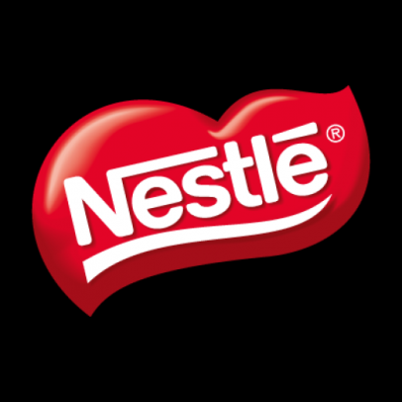

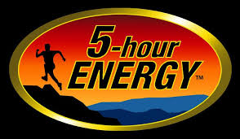




And countless others

Slide 13
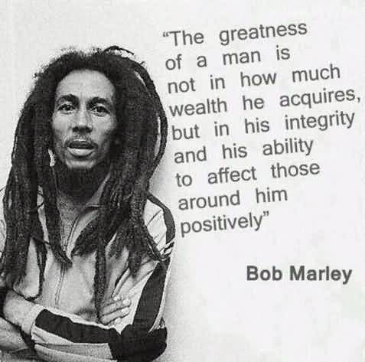
“Success will come and go, but integrity is forever.” --Forbes
Integrity means doing the right thing at all times and in all circumstances, whether or not anyone is watching. It sometimes takes great courage to do the “right thing,” no matter the consequences. Building a reputation of integrity can take years, but integrity can be lost in only seconds.

Slide 14
--Workplace examples--
You are using the company restroom and use up the last roll of toilet paper, or the last piece of paper towel. Without thought for the needs of the next employee, you go back to work rather than addressing the issue.
What If . . .
Another employee is waiting at the door and enters after you leave?
The next employee gets severely injured due to a fall/slip?

Slide 15
--Workplace examples--
You call in sick to your supervisor because after a long and cold winter this is the first nice day at the beginning of spring and you want to go shopping, bike riding, or just be at home to work in prepping your garden. You want to be anywhere but work on this beautiful day.
What If . . .
The business was robbed and the employee who replaced you was killed?
That was the day the boss decided to handout airplane tickets to a free vacation in Hawaii?

Slide 16
--Workplace examples--
You place your dirty cup in the lunchroom sink. With a guilty glance around the room, you find no one watching and quickly leave the lunchroom.
What If . . .
The boss enters the lunchroom with guests and later fires the secretary/receptionist for not keeping the area clean and presentable?
Health and Safety has conducted a surprise inspection and the company now has to pay a large fine for unsafe eating areas?

Slide 17
--Workplace examples--
Your company sponsors events, activities, or lunches and you sign up to attend and fail to show. Conversely, you fail to sign up and show up anyway. You make the behavior worse when you say that you took the appropriate actions so someone else must have screwed up.
What If . . .
The event coordinator is fired for putting the company in a bad situation when not enough seats/food is available?
As a result of your failure to attend, and perform your assigned duty, audio equipment was not properly set up and the event was delayed over an hour?

Slide 18
--Workplace examples--
You hoard supplies in your desk drawer so you won’t run out while other employees go without supplies they need to do their work.
What If . . .
The supply budget has been depleted for the financial term and other employees have had to purchase office supplies with their own money?
You call in sick and the person assigned to your desk finds your hoard and shows the boss?

Slide 19
--Workplace examples--
Two team members are discussing another team member’s failure to perform to their standards. They are talking critically about the individual’s lack of skill and imagination. They are criticizing the employee’s follow through efforts and his production results. You are in a nearby room and hear the conversation. You hear them make a decision to report their feelings to the boss.
What If . . .
That employee has a terminal illness that you and the boss are aware of?
The boss discovers that you overheard the critical conversation and did nothing?

Slide 20
